Slide 1
The Next Generation Analytics Function:
Six Skills to Make Your Team Future Proof
Presented By:
Kassandra Barnes Director of Product Marketing & Customer Intelligence
@ChiCityK
Notes:
Be sure to introduce yourself and earn the right.
Staffing firms spend a good deal of time and money building a candidate experience that will keep their talent pipelines well-stocked, but how much of that investment is hindered by technology – or lack thereof? Technology can be your greatest ally or enemy. Job seekers today expect the application process to be fast, informative, more personalized – and mobile-optimized. Furthermore, the more in-demand one’s skill set is, the less likely the job seeker will be to jump through hoops. In this presentation we explore five major barriers that can kill your candidate and client experience.
What would you say is your biggest technology challenge? (Or use a different question to set the stage and get the audience engaged emotionally.)
Think about the job seekers coming up against these roadblocks.

Slide 2
Who are you?
You manage a team?
You are looking for a new job?
You are a vendor who hasn’t been able to track me down yet?

Slide 3
Who am I?
My team works solely on B2B Research.
Our team is within Corporate Marketing.
We are a sales led organization shifting to a product led organization.
My team is small, relatively speaking.
We do 90% of our research “in house”.
MOST IMPORTANTLY
…I have made a bad hire before. A really bad hire.
And it was my first hire ever.

Slide 4
$25,000
Source: CareerBuilder Skills Gap Study 2013
Notes:
That one question we are trying to really answer about one another is this simple – yet so complex: Are you the right one?
And that’s what the search process – both for job-seekers and employers are trying to uncover.

Slide 5
What We’ll Talk About:
What do skills actually mean in hiring?
Six Skills to Future Proof Your Team (or you!)
Ways to Start Hiring or Training for these Skills Now

Slide 6
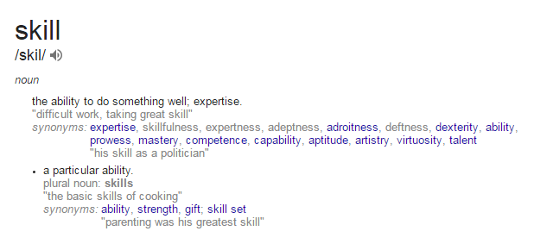
What is a skill?

Slide 7
Hard vs. Soft Skills
What’s the Difference?
Hard Skills
Tangible skills that come from experience, training, practice or education.
Soft Skills
Related to personality, behavior and emotional intelligence.

Slide 8
The Ideal is the Best of Both Worlds
Hard Skills
Soft Skills
Perfect Blend

Slide 9
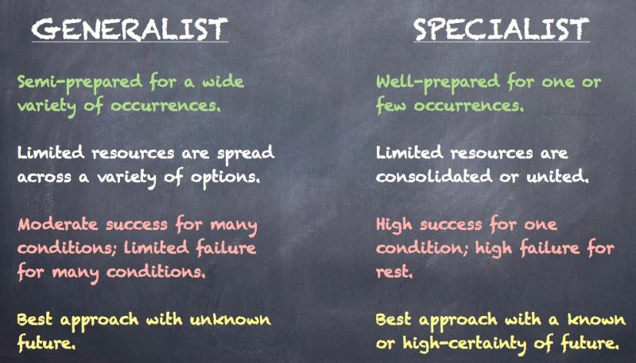
Are you hiring specialists or generalists?

Slide 10
A bit of both. Enough to be dangerous.

Slide 11
Six Skills Needed Today
1
2
3
4
5
6
Accuracy
Urgency
Visualizer
Storyteller
Marketer
Networker

Slide 12
Accuracy and Attention to Detail
1

Slide 13
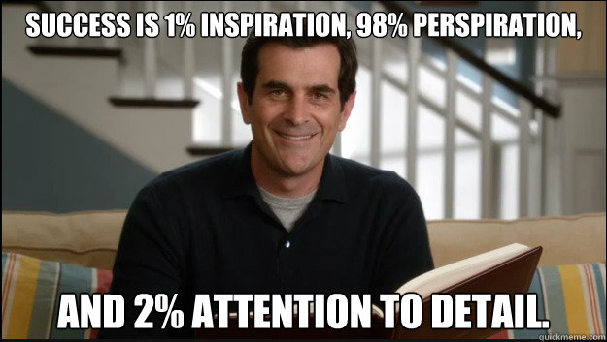
Accuracy Matters

Slide 14
At any given moment in an enterprise
40% of data is missing, wrong or incomplete.
Source: Gartner
Notes:
That one question we are trying to really answer about one another is this simple – yet so complex: Are you the right one?
And that’s what the search process – both for job-seekers and employers are trying to uncover.

Slide 15
Hiring for Accuracy
Tip
Provide a client-facing/stakeholder report and a set of data. Intentionally transpose data in the report. See how many errors someone catches.
BONUS: Hate spelling, formatting and grammar errors in reports too? Test that as well.

Slide 16
An Internal Sense of Urgency
2
Notes:
We already talked about how competitive the market is right now, but have you gone through your own application process?

Slide 17
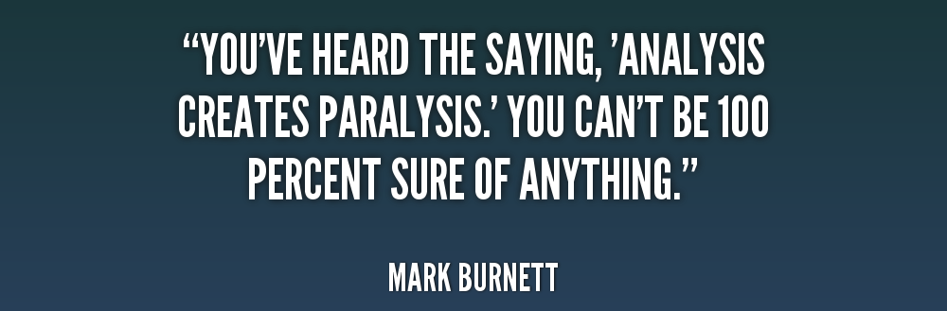
Avoid People Who Fall for this Trap

Slide 18
Biggest Frustration with Research Today?
We aren’t much faster than this guy.
Notes:
How many of you have tried applying to one of your open jobs in the last year?
Only about 31% of employers according to our research claim to have done so. It’s important to regularly audit your application process and see if there are ways to shorten or eliminate steps in the process.
And the reason being is…

Slide 19
Hiring for Urgency
Tip
Scenario Question: Provide an illustrative research study example (type of study, sample size, analysis needed). Ask them to map out an estimated time frame for completion of the project.
BONUS: I hire mostly people from the vendor side of research, or someone who has worked in client service vs. client side only.

Slide 20
Great Visualizers
3

Slide 21
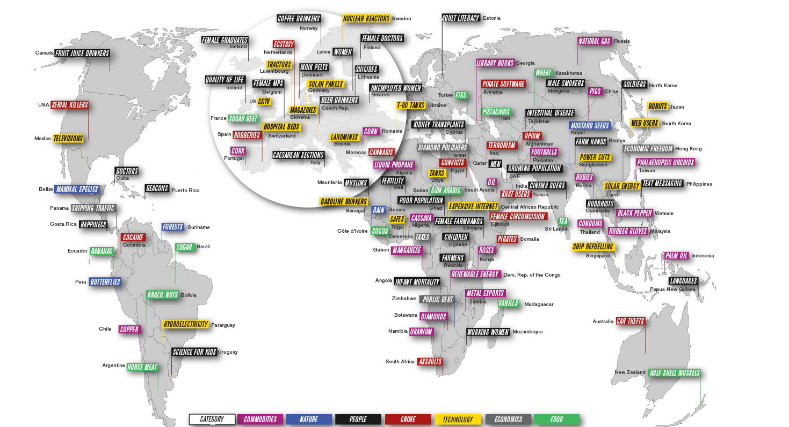
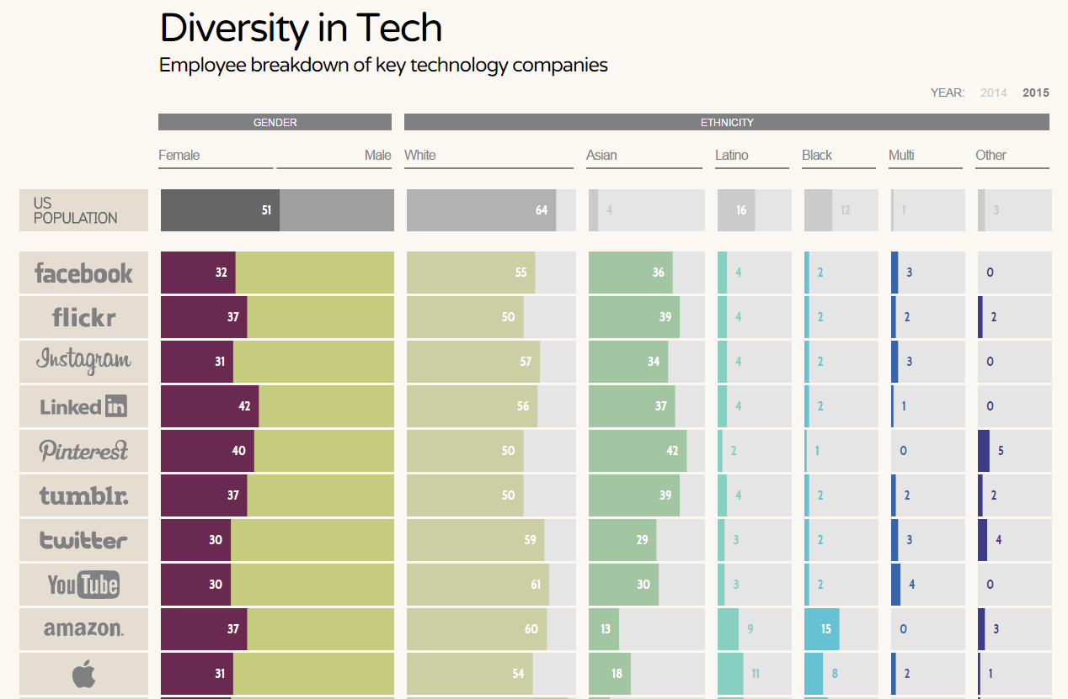
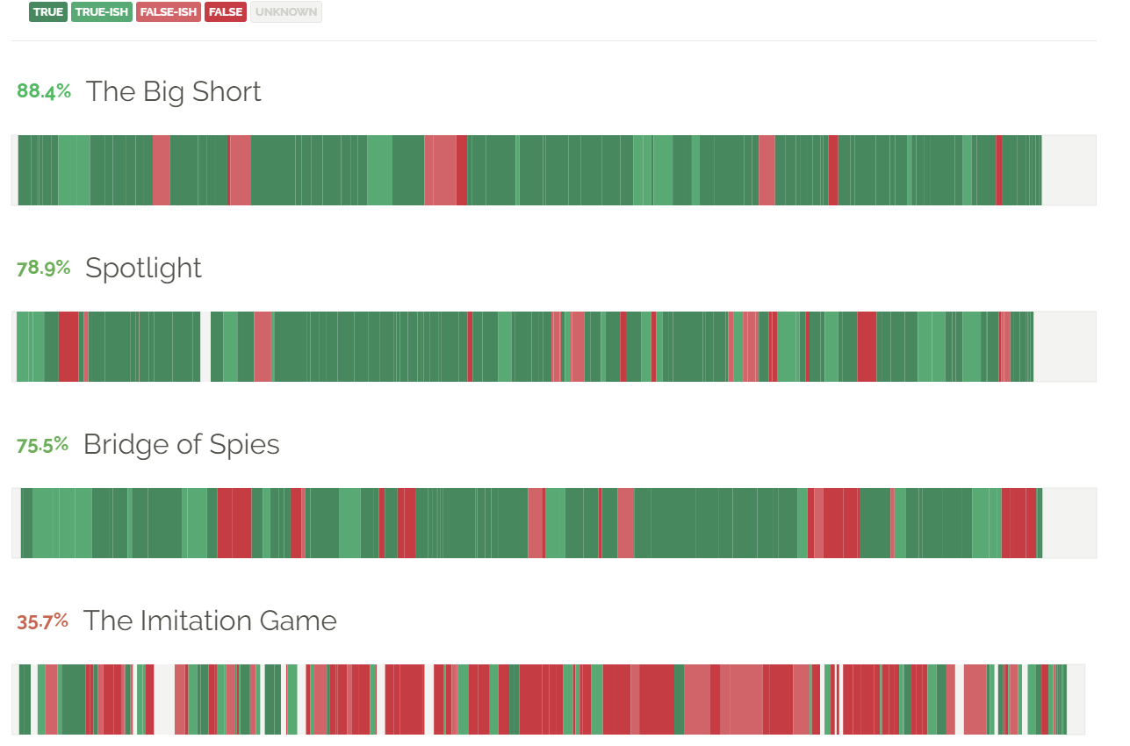
Informationisbeautiful.net

Slide 22
Hiring for Great Visualizers
Tip
Homework: Provide a raw data set and ask them to visualize a high-level executive summary of the data.
BONUS: Put it in front of your sales team and ask if they understand what the data means.

Slide 23
Know How To Tell a Story
4

Slide 24
Five Components of Storytelling
Just don’t lie, ok?
Simple
Emotional
Truthful
Real
Valid
Notes:
1. Simple
Good stories are easy to understand. They're also told in a language that matches the way the intended audience communicates, so they don't need to spend time interpreting and then absorbing. Simplicity also aides in memorability, because the overall lesson is easy to grasp in summary.
2. Emotional
Just like Roy Henry, who experiences the stories he tells as he's telling them, good storytelling requires an emotional component. Most of the memorable ones have humour, pain or joy (sometimes all three). If every story were simply facts stated, one after another, most of us wouldn't listen or remember any of it.
3. Truthful
Not truth in the scientific sense, where there's an objective fact stated, but true insofar as the teller believes in what they're saying and are honest with themselves and their audience about it.
4. Real
Good stories are first-hand experiences the teller actually witnessed. Even if it's a story that's passed on generationally, an effective one still has an element of how that story relates directly to the teller, told in the teller's own words.
5. Valid
Regardless of the audience size, a good story works for any audience. One to one-million. It isn't concerned with how many people can hear it, just that someone, somewhere is listening to it.

Slide 25
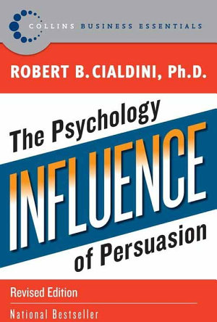
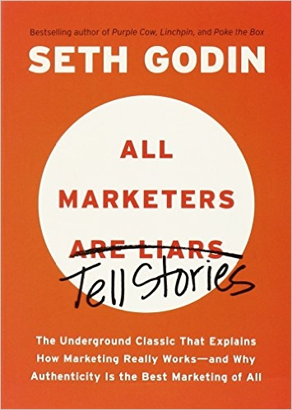
Two of my favorite books on this topic:

Slide 26
Hiring for Storytellers
Tip
Behavioral Question: In an interview, ask them to tell you a story. Seriously.
BONUS: Give an unstructured research report to them and have them compose the report into a story.

Slide 27
Know Marketing Fundamentals
5
Notes:
How many of you have a re-engagement strategy in place?

Slide 28
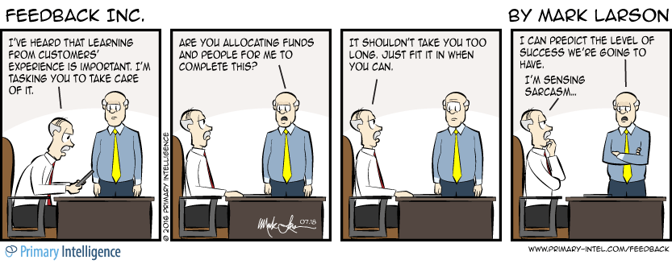
P’s of Marketing – Why is this important for research?

Slide 29
Hiring for Marketers
Tip
Interview Question: Ask “what product (consumer or business) do you feel is not properly marketed today and why?”
BONUS: Give them any random object and ask them to sell it to you in 5 minutes.

Slide 30
Master Networkers
6
Notes:
How many of you have a re-engagement strategy in place?

Slide 31
Ever work with these?

Slide 32
Easiest Way to Break Silos is Connection
Data is the Bridge Between the Business

Slide 33
Hiring for Networkers
Tip
Recon Work: Review their social media profiles, how many friends/connections do they have?
BONUS: Ask what cross-functional teams they have partnered with in their previous roles and to outline a successful cross-functional project they worked on.

Slide 34
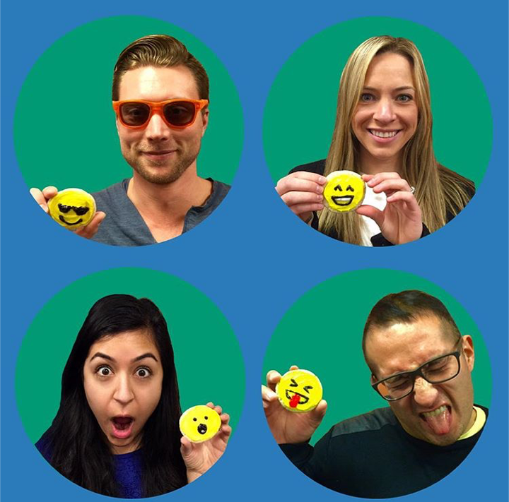
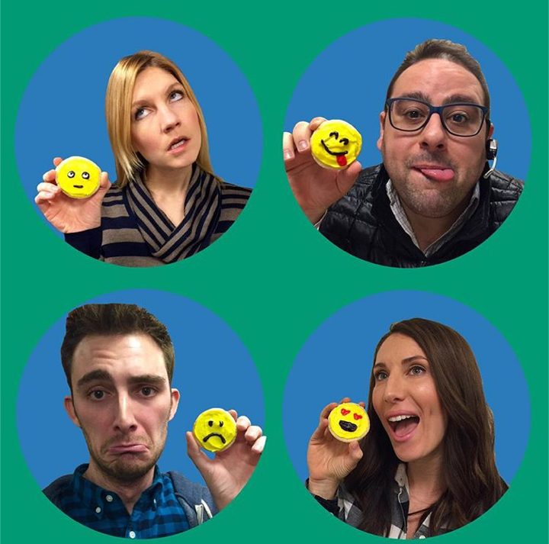
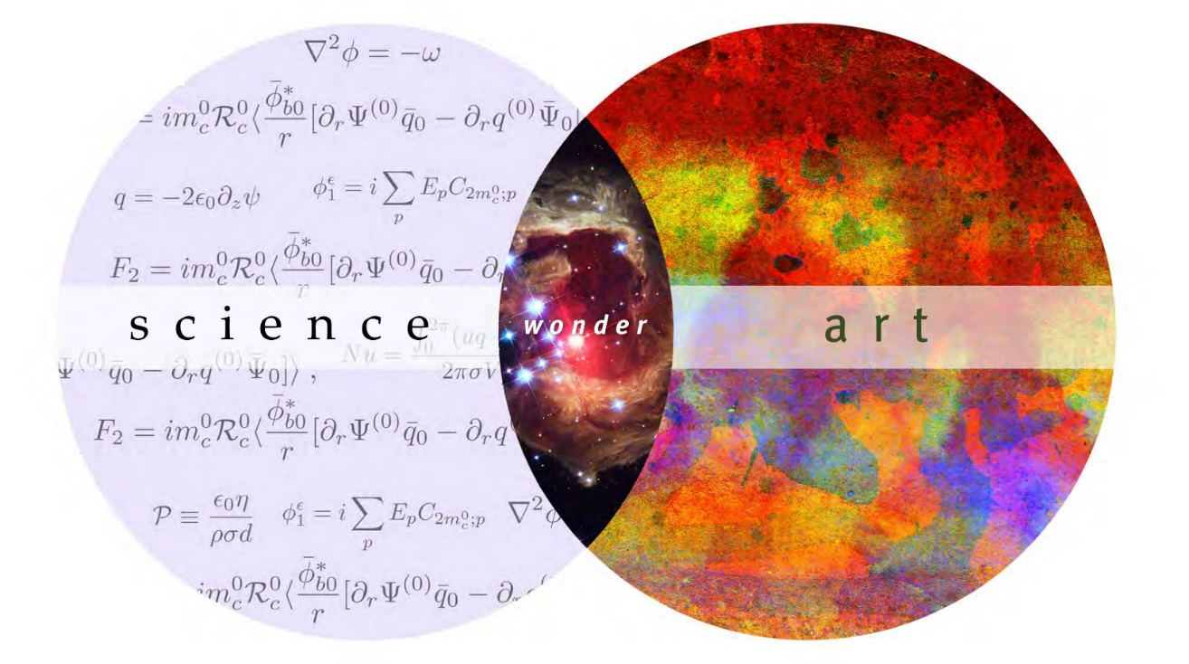
End of the Day, Hiring is an Art and a Science.
Because, how can you measure this?

Slide 35
Which of these skills do you need on your team today?
1
2
3
4
5
6
Accuracy
Urgency
Visualizer
Storyteller
Marketer
Networker

Slide 36
QUESTIONS? kassandra.barnes@careerbuilder.com

